Slide 1


AIRLINE BUDDY
MEERA AMEERA

Slide 2
PART 1
Sentiment Analysis of Customer Reviews on 10 different airlines
1) Data Collection
Collected customer review data
2) Pre-processing
Created Sentiment Labels (positive/negative/neutral)
Tokenization
Stopword Removal
Lemmatization
Sentence Embedding
Vectorization
3) Evaluation
Tested on unbalanced, balanced, and fine-tuned datasets
Generated performance metrics including accuracy, precision, recall, and F1-score
Used Confusion Matrix for error analysis
4) Model Selection
Logistic Regression (Balanced)

Slide 3
PART 2
Two main functions of the AirlineBuddy Chatbot
BASIC USER INTERACTION
USER QUERY INTERACTION
Enables users to ask questions about airline-related topics, such as baggage policies, special services & assistance, Loyalty & Rewards Programs, and more. Responses will be dynamically generated using Retrieval-Augmented Generation (RAG).
Allows users to submit reviews on various airlines.

Slide 4
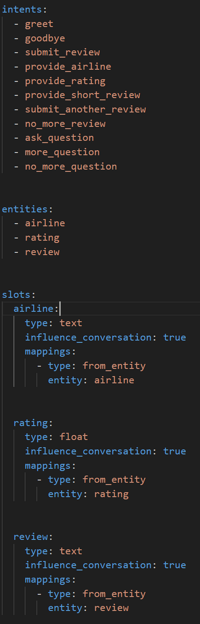
Intents
1) General Interaction:
greet – Handles user greetings
goodbye – Manages user farewells
2) Review Submission:
submit_review – Initiates the review process for an airline.
provide_airline – Captures the airline name the user wants to review.
provide_rating – Records the user’s rating for an airline.
provide_short_review – Allows the user to submit a brief review.
submit_another_review – Let the user submit another review after finishing one.
no_more_review – Ends the review process when the user has no more reviews to submit.
3) User Queries:
ask_question – Handles general questions related to airlines
more_question – Allows the user to continue asking more questions.
no_more_question – Ends the query session when the user has no further inquiries.
Entities
airline – Represents the airline name mentioned by the user.
rating – Stores the numerical rating provided by the user.
review – Captures the text-based review given by the user.
Slots
1) Airline Slot:
Type – text
Mapping – Extracted from the airline entity.
2) Rating Slot:
Type – float
Mapping – Extracted from the rating entity.
3) Review Slot:
Type – text
Mapping – Extracted from the review entity.

Slide 5
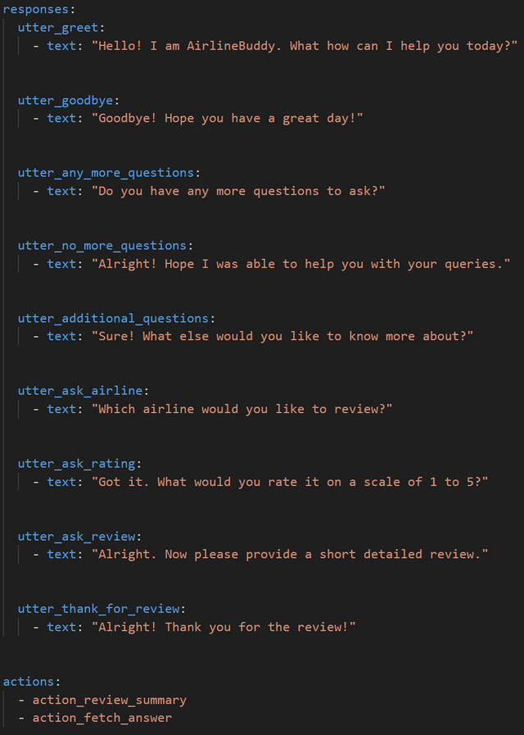
Responses
1) General Interaction:
utter_greet – Greets the user and asks how it can help.
utter_goodbye – Ends the conversation with a farewell message.
2) Handling Questions:
utter_any_more_questions – Asks if the user has any more questions.
utter_no_more_questions – Closes the conversation if no more questions are asked.
utter_additional_questions – Encourages the user to ask more queries.
3) Review Submission:
utter_ask_airline – Prompts the user to provide the name of the airline they want to review.
utter_ask_rating – Asks the user to provide a rating on a scale of 1 to 5.
utter_ask_review – Requests a short, detailed review from the user.
utter_thank_for_review – Acknowledges the user's review submission.
Actions
action_review_summary
Processes and summarizes the user's submitted airline review.
Review data is stored in MySQL database
action_fetch_answer
Retrieves relevant answers to user queries using RAG (Retrieval-Augmented Generation).

Slide 6
CONVERSATION FLOW 1
1) Greeting
Bot: Greets the user and asks how it can help.
User: Directly states their request.
Submitting an airline review
Asking airline-related questions
2) Submit an Airline Review
User: States that they want to submit a review.
Bot: Asks for the airline name.
User: Provides the airline name.
Bot: Requests a rating on a scale of 1 to 5.
User: Provides a rating.
Bot: Asks for a short detailed review.
User: Submits a review.
Bot: Confirms the submission and summarizes the review details.
Bot: Asks if the user wants to submit another review.
If Yes → Restarts the review process.
If No → Thank the user for their review.

Slide 7
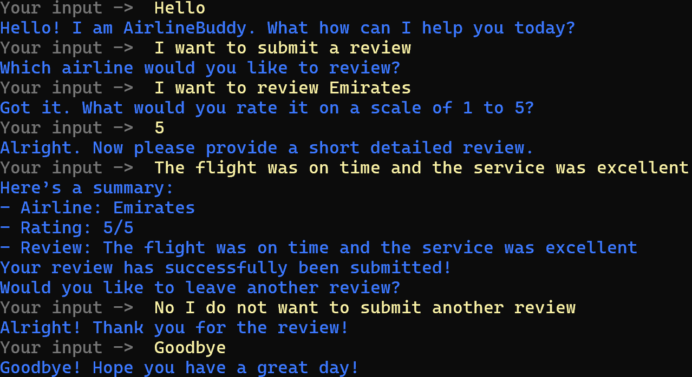
SAMPLE 1
Submit an airline review

Slide 8
CONVERSATION FLOW 2
1) Greeting
Bot: Greets the user and asks how it can help.
User: Directly states their request.
Submitting an airline review
Asking airline-related questions
2) Ask Airline-Related Questions (RAG-powered)
User: Asks a question regarding airline services, policies, features and more.
Bot: Retrieves and generates a response using RAG.
Bot: Asks if the user has any more questions.
If Yes → Allows the user to ask additional queries.
If No → Ends the query session.

Slide 9
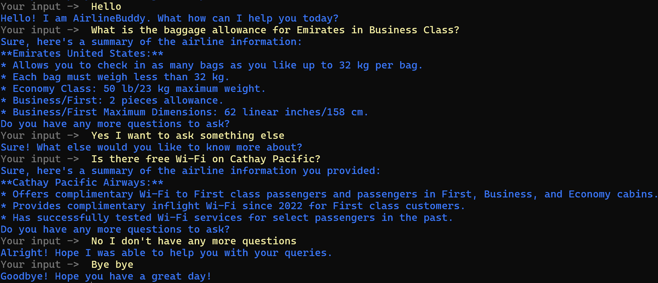
SAMPLE 2
Ask Airline-Related Questions (RAG-powered)

Slide 10
THANK YOU

